Slide 1
Data Lakes, layers and ETL
Submitted By
Maimoona Khilji

Slide 2
Content
Concepts of Data Lakes
Why we use data lake?
How is data stored in Data Lake?
Bronze / Silver / Gold layers
ETL
What does it mean?
Why is it important in Data engineering?

Slide 3
Data Lakes
A data lake is a centralized repository that allows you to store all your structured and unstructured data at any scale. You can store your data as-is, without having to first structure the data, and run different types of analytics—from dashboards and visualizations to big data processing, real-time analytics, and machine learning to guide better decisions
A data lake provides a scalable and secure platform that allows enterprises to:
ingest any data from any system at any speed—even if the data comes from on-premises, cloud, or edge-computing systems;
store any type or volume of data in full fidelity;
process data in real time or batch mode;
analyze data using SQL, Python, R, or any other language, third-party data, or analytics application.

Slide 4
Why we use data lake?
There are two main reasons to use data lake:
Data lakes store sets of Big data that can include a combination of structured, unstructured and semi structured data. Such environments aren't a good fit for the relational databases that most data warehouses are built on. Relational systems require a rigid schema for data, which typically limits them to storing structured transaction data. Data lakes support various schemas and don't require any to be defined upfront. That enables them to handle different types of data in separate formats.
As a result, data lakes are a key data architecture component in many organizations. Companies primarily use them as a platform for big data analytics and other data science applications requiring large volumes of data and involving advanced analytics techniques, such as data mining, predictive modeling and machine learning.

Slide 5
How is data stored in Data Lake?
A data lake is a centralized repository designed to store, process, and secure large amounts of structured, semi structured, and unstructured data. It can store data in its native format and process any variety of it, ignoring size limits.
When storing data, a data lake associates it with identifiers and metadata tags for faster retrieval.
A traditional data warehouse stores data in hierarchical dimensions and tables, a data lake uses a flat architecture to store data, primarily in files or object storage.
Data lakes are often associated with Hadoop systems. In deployments based on the distributed processing framework, data is loaded into the Hadoop Distributed File System (HDFS) and resides on the different computer nodes in a Hadoop cluster. Increasingly, though, data lakes are being built on cloud object storage services instead of Hadoop. Some NoSQL databases are also used as data lake platforms.

Slide 6
Data lakes vs. Data warehouses
Data lakes | Data Warehouse
Types of data
All types: Structured data, semi-structured data, unstructured (raw) data | Structured data only
Reliability
Low quality, data swamp | High quality, reliable data
Performance
Poor | High
Ease of use
Difficult: Exploring large amounts of raw data can be difficult without tools to organize and catalog the data | Simple: Structure of a data warehouse enables users to quickly and easily access data for reporting and analytics

Slide 7
Data lakes vs. Data warehouses
Data lakes | Data Warehouse
Schema-on-read vs schema-on-write
It has no predefined schema, which allows it to store data in its native format. | The schema of a data warehouse is defined and structured before storage (schema is applied while writing data).
Complex vs simple user accessibility
As data is not organized in a simplified form before storage, a data lake often needs an expert with a thorough understanding of the various kinds of data and their relationships, to read through it | A data warehouse is easily accessible to both tech and non-tech users due its well-defined and documented schema. Even a new member on the team can begin to use a warehouse quickly.
Flexibility vs rigidity
However, data lakes can adapt to changes easily. Also, as the need for storage capacity increases, it is easier to scale the servers on a data lake cluster. | With a data warehouse, not only does it take time to define the schema at first, it also takes considerable resources to modify it when requirements change in the future

Slide 8
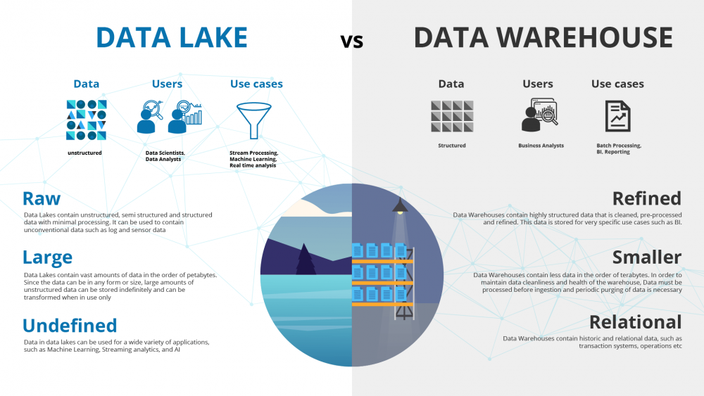

Slide 9
The Layered Data Lake approach: Bronze, Silver & Gold
A drawback we typically see is that all data is just dumped into one big data lake without any structure and then exposed to everyone. While exporting your data and building-up history, this may already result in some checks-in-the-box for your data lake implementation, but it lacks long-term planning.
Not all data is easy to work with for data engineers; technical keys need to be transformed to terms that make sense, some files needs aggregation and some files need to be merged together to be able to work with them.
To tackle these problems, we suggest working with a layered approach (also referred to as the Multi-Hop Architecture):
Bronze Layer
Silver Layer
Gold Layer
Notes:
Bronze Layer: A one-on-one copy of the data from the source into the data lake. ‘Bronze data’ is raw untransformed unmodified data and all your sources land into this layer.
Silver Layer: Once a business case has been identified and requires analysis, the ‘raw Bronze data’ is transformed into sets of data that add additional values. This can imply replacements of codes to meaningful values, adding sanity constraints, filtering-out unneeded information, … . Hence, resulting in concise useful datasets that may be used by other pieces of information as well.
Gold Layer: The gold layer then provides a well-constructed dataset ready for analysis by data scientists and business analysts. The data is presented in such a way that appeals to them the most, which may include aggregations, joins and merges, encoding, etc.
In a typical scenario we can harvest data from our products from different source systems. All these sources then land into the bronze layer as a one-on-one copy. The data of all these sources is then blended in the Silver layer that results in one single source of the ‘product’ information. This ‘Product’ silver dataset can be used in several datasets that are presented to users in the gold layer (e.g. stock keeping unit dataset, market basket analysis, …).

Slide 10
Bronze, Silver & Gold Layer
Bronze Layer:
A one-on-one copy of the data from the source into the data lake. ‘Bronze data’ is raw untransformed unmodified data and all your sources land into this layer.
Silver Layer:
Once a business case has been identified and requires analysis, the ‘raw Bronze data’ is transformed into sets of data that add additional values. This can imply replacements of codes to meaningful values, adding sanity constraints, filtering-out unneeded information. Hence, resulting in concise useful datasets.
Gold Layer:
The gold layer then provides a well-constructed dataset ready for analysis by data scientists and business analysts. The data is presented in such a way that appeals to them the most, which may include aggregations, joins and merges, encoding, etc.

Slide 11
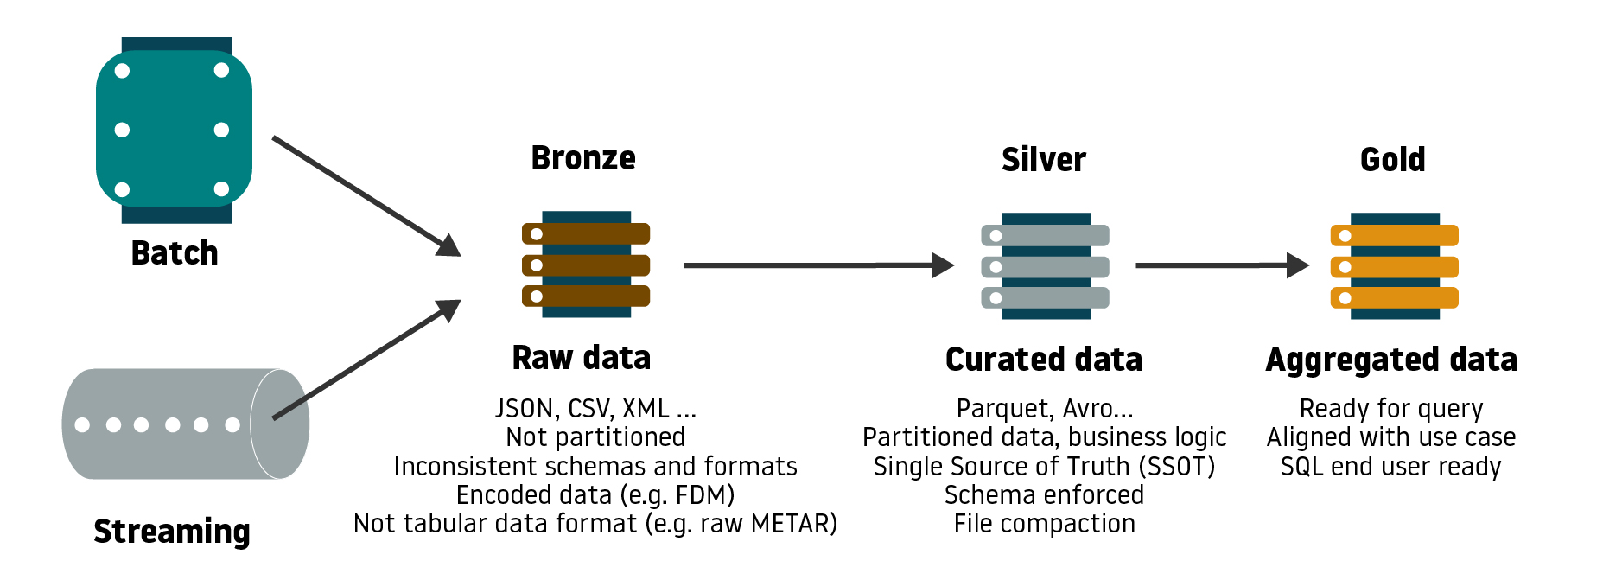
Bronze, Silver & Gold Layer
Notes:
In a typical scenario we can produce data from our products from different source systems. All these sources then land into the bronze layer as a one-on-one copy. The data of all these sources is then blended in the Silver layer that results in one single source of the ‘product’ information. This ‘Product’ silver dataset can be used in several datasets that are presented to users in the gold layer (e.g. stock keeping unit dataset, market basket analysis, …).

Slide 12
ETL
ETL stands for Extract, Transform, Load
ETL is a data integration process that combines data from multiple data sources into a single, consistent data store that is loaded into a data warehouse or other unified data repository.
ETL provides the foundation for data analytics and machine learning work streams.
Through a series of business rules, ETL cleanses and organizes data in a way which addresses specific business intelligence needs, like monthly reporting, but it can also tackle more advanced analytics, which can improve back-end processes or end user experiences. ETL is often used by an organization to:
Extract data from legacy systems
Transform or Cleanse the data to improve data quality and establish consistency
Load data into a target database

Slide 13
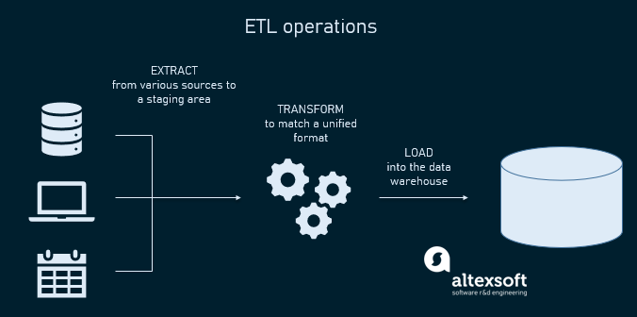
ETL

Slide 14
Importance of ETL in Data Engineering
Data engineers use ETL processes to extract data from different sources, transform the data into a usable and trusted resource, and load that data into the systems end-users can access and use downstream to solve business problems.
First, data engineers construct a data warehouse. The tried and true process that data engineers use is called ETL — Extract, Transform, Load.
ETL is required for data engineers. Traditional ETL experience may be valuable as data engineers may need to gather data from various sources, transform structured and unstructured data into useful information, clean up data, etc.

Slide 15
How ETL works - Extract
Extract:
During data extraction, raw data is copied or exported from source locations to a staging area. Data management teams can extract data from a variety of data sources, which can be structured or unstructured. Those sources include but are not limited to:
SQL or NoSQL servers
CRM and ERP systems
Flat files
Email
Web pages

Slide 16
Transform
Transform:
In the staging area, the raw data undergoes data processing. Here, the data is transformed and consolidated for its intended analytical use case. This phase can involve the following tasks:
Filtering, cleansing, de-duplicating, validating, and authenticating the data.
Performing calculations, translations, or summarizations based on the raw data. This can include changing row and column headers for consistency, converting currencies or other units of measurement, editing text strings, and more.
Conducting audits to ensure data quality and compliance
Removing, encrypting, or protecting data governed by industry or governmental regulators
Formatting the data into tables or joined tables to match the schema of the target data warehouse.

Slide 17
Load
Load:
In this last step, the transformed data is moved from the staging area into a target data warehouse. Typically, this involves an initial loading of all data, followed by periodic loading of incremental data changes and, less often, full refreshes to erase and replace data in the warehouse. For most organizations that use ETL, the process is automated, well-defined, continuous and batch-driven. Typically, ETL takes place during off-hours when traffic on the source systems and the data warehouse is at its lowest.

Slide 18
References
https://www.databricks.com/discover/data-lakes/introduction
https://cloud.google.com/learn/what-is-a-data-lake
https://www.techtarget.com/searchdatamanagement/definition/data-lake
https://aws.amazon.com/big-data/datalakes-and-analytics/what-is-a-data-lake/
https://lytix.be/things-to-consider-when-creating-a-data-lake/
https://www.ibm.com/cloud/learn/etl#:~:text=ETL%2C%20which%20stands%20for%20extract,warehouse%20or%20other%20target%20system.

Slide 19
THE END

